Slide 1

HMO HEALTHCARE
RECOMMENDATIONS FOR LOWERING HEALTHCARE COSTS
IST 687
Rhiannon Abrams, Wei Leah Liao, Enubi Kim, and Haotian Shen

Slide 2

INTRODUCTION
From the HMO Healthcare data, we had two goals:
Predict what types of people will spend a lot of money on healthcare next year.
Provide helpful insight and a recommendation into how total healthcare costs can be lowered, especially for people who have high healthcare costs.
2
Notes:
PROJECT GOAL AND OBJECTIVE

Slide 3
BUSINESS QUESTIONS:
WHAT WAS FOCUSED ON
Why are some people’s health costs more expensive than others?
Can we predict which people will be expensive?
In terms of health care costs.
Which people will have high healthcare costs?
What are some recommendations for lowering healthcare costs?
3
Notes:
Why are some people’s health costs more expensive than others?
why do some people require more than others?
can we predict which people will be expensive?
in terms of health care costs.
which people will have high healthcare costs?
What are some recommendations for lowering healthcare costs?

Slide 4
THE PROJECT AGENDA
PHASE ONE:
LOAD THE DATA WITH APPROPRIATE LIBRARIES
PHASE TWO:
EXPLORE THE DATA
PHASE THREE:
CLEAN THE DATA
PHASE FOUR:
OVERVIEW OF IMPORTANT VARIABLES
PHASE FIVE:
DATA MODELING AND TRENDS
PHASE SIX:
CONCLUSION AND RECOMMENDATIONS
4
Notes:
So, for our overall project, this was the agenda we followed. We have phases 1-6 and this was all vital for making our models to then our predictions and recommendations.
for phase one, we had to load the data and load the appropriate libraries to create our models which would then lead to our results and recommendations.
in phase two we had to explore the data:
we had to see what the variables are, if there were any values (data) missing, or if there was values that were incomplete, and to see if we needed to add any columns.
phase three:
cleaning the data.
this is where we fill in the gaps of the missing data
adding columns such as the Expensive column
simplifying variables
and we’ll go into more detail in the next few slides
PHASE FOUR AND FIVE ARE COMBINED FOR US:
DETERMINING WHAT VARIABLES ARE IMPORTANT AND THEN WHICH MODELS WORK BEST.
PHASE SIX:
MAKING SUGGESTIONS AND CONCLUSIONS

Slide 5
PHASE THREE
Cleaning the Data

Slide 6
PHASE THREE
Cleaning the data:
Got rid of incomplete observations and used estimation techniques to fill the gaps of the missing data.
Setting the boundary for what’s deemed Expensive and Not Expensive:
80% of people spend less than or equal to $5789.40
Expensive means a person spends greater than or equal to $6000.
6
Notes:
like previously stated, this is where we fill in the gaps of the missing data by using techniques that would make the best estimate that would fit in those spots by analyzing other values around the gap.
THEN WE NEED TO SET A BOUNDARY FOR WHATS DEEMED EXPENSIVE OR NOT EXPENSIVE:
SO after inspecting the Cost variable, it was found that the 80th percentile, aka 80% of people in that data, were spending around $5789.40 on healthcare. And when graphing this, we also saw that many people were paying more than average.
so, initially, from this information, it was decided that a person is considered expensive when they pay greater than or equal to $6000 on healthcare. This is also how we defined a new variable/ column in our data set called Expensive.
the column was either a yes or a no.
if a person was paying greater than or equal to $6000, it would be a yes, and if they were paying less than, it would be a no.

Slide 7
PHASE THREE
Variables we combined for convenience:
Number of Children → children or not (yes or no)
Educational Level → educated or not (yes or no)
Grouped Age Groups → under 18, 20-29, 30-39,... over 60
Grouped BMI
Under 18.5 = Underweight,
Between 18.5-24.9 = Normal Weight,
Between 24.9-29.9 = Overweight,
And >= 29.9 = Obesity
7
Notes:
these are the variables that we simplified to help with cleaning our data.
THE OBESE FACTOR IS IMPORTANT IN OUR MODELING.

Slide 8
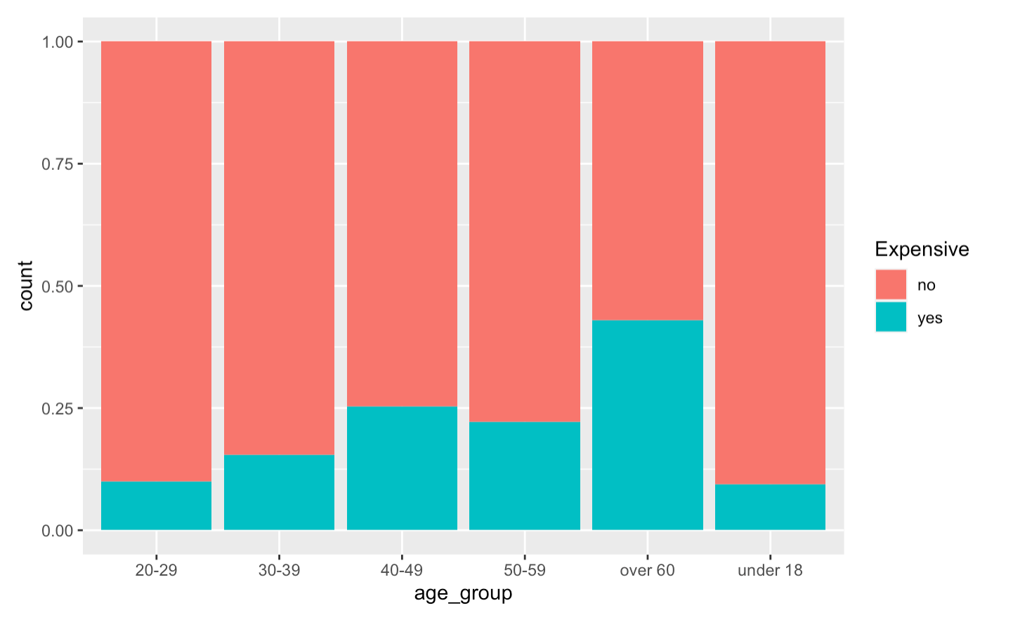
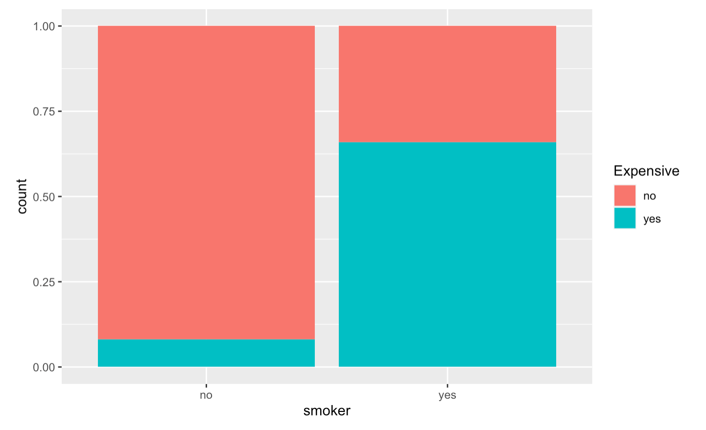
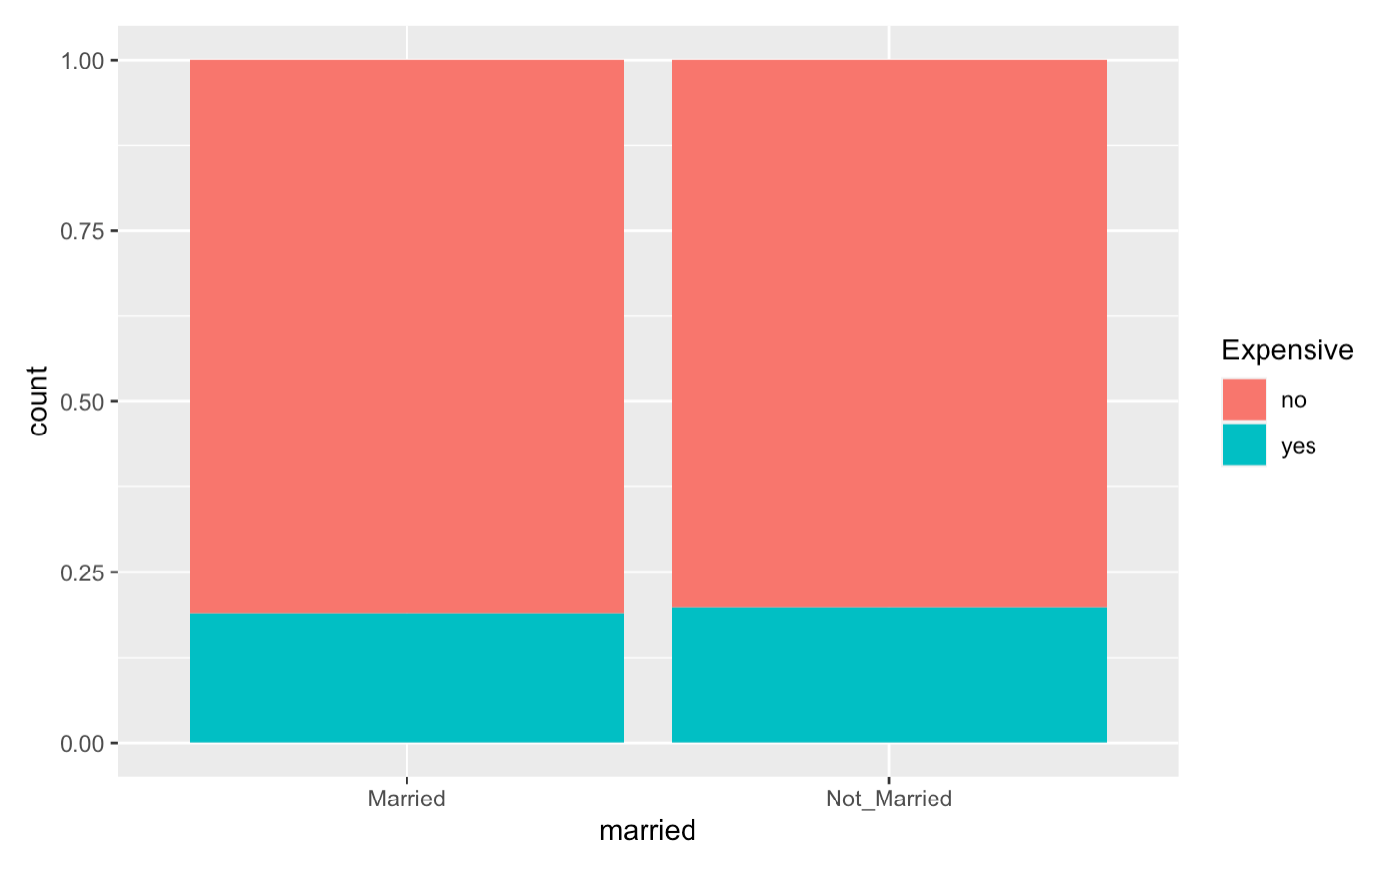
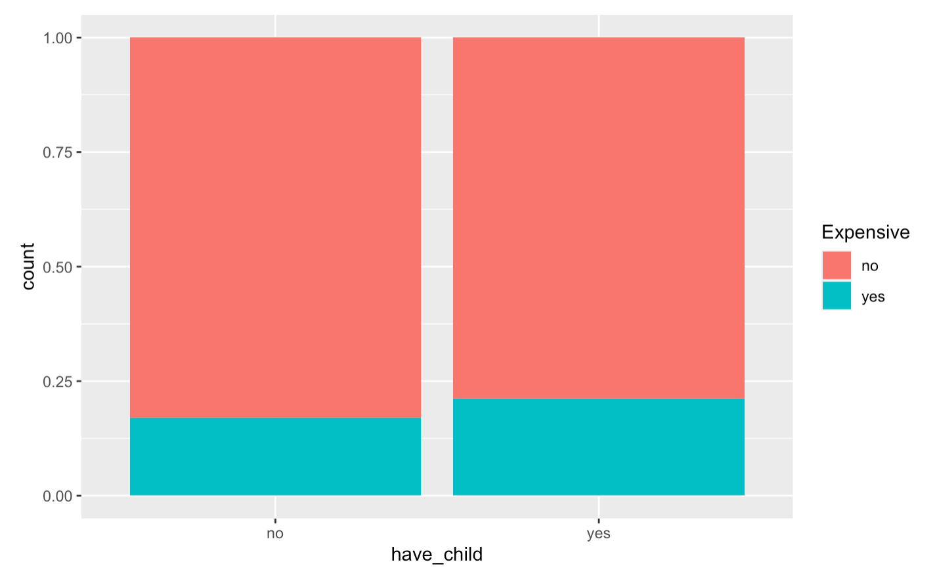

8
Notes:
so here are some graphs that we generated. these aren’t all of them, we just wanted to show some similar and contrasting results.
this is comparing different variables with whether or not they’re expensive.
top left is age groups:
so for the 20-29 age group, a small portion of them were considered expensive, and a majority of them were classified as not expensive.
comparing that group to the over 60 age group, we can see that there is a greater amount of over 60 folks that were classified as expensive.
on the top right, we had the variable smoker (this was whether or not they smoked) AND IT WAS compared to whether or not they’re expensive in terms of healthcare costs.
for people who’re non-smokers, a majority of them are classified as not expensive, and a very small amount are considered expensive.
but as you can see, for people who are smokers, a majority of them have healthcare costs that are greater than or equal to $6000, classifying them as expensive. This is an important variable in determining why someone may have high healthcare costs or not.
in contrast, the bottom two graphs show that not all variables have drastic differences in whether they’re considered expensive or not.

Slide 9
PHASES FOUR & FIVE
Determining what variables are important, and modeling them.
Notes:
This is where we generated models of our variables to see how accurate we are, and also helped us narrow down which variables we should focus on that may help determine which groups have the highest healthcare costs and leading to recommendations for lowering them.

Slide 10
PHASES FOUR & FIVE
We conducted six initial analyses for our data.
Started with a linear regression model.
The data needed to be analyzed with more complicated methods.
The more complicated methods improved the results of our analyses.
10
Notes:
what are linear models and what do they mean?
a linear regression model describes and can show the relationship bwn dependent or independent variables.
dependent variables are response variables and they affected by the independent variables which can also be called the explanatory or the predictors.
our linear regression models was not good, but it was a good place to start to and set the bar for our further exploration and analyses.
The more complicated methods we speak of means we had to use models that better represented and helped interpret our data.
then we found that the more complicated models improved our results.
SO IN THE NEXT FEW SLIDES, I’M JUST GOING TO SHOW WHAT THE MODELS LOOKED LIKE. but i will talk more on the final model out of these six.

Slide 11
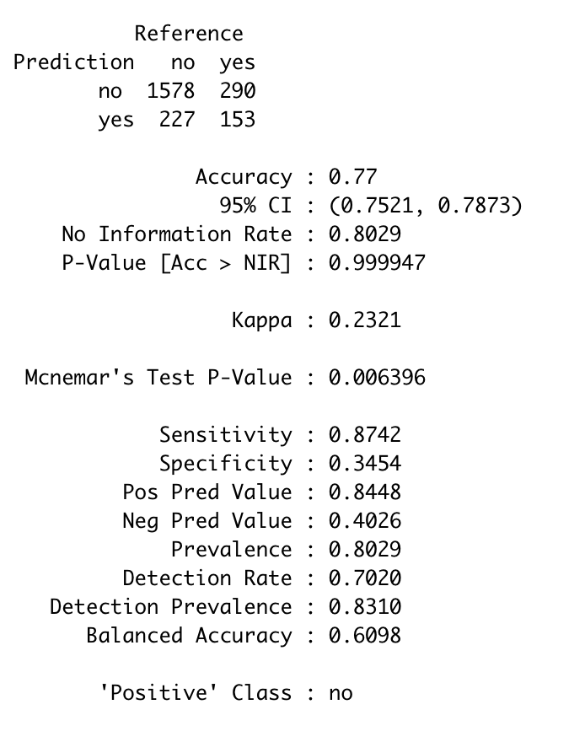
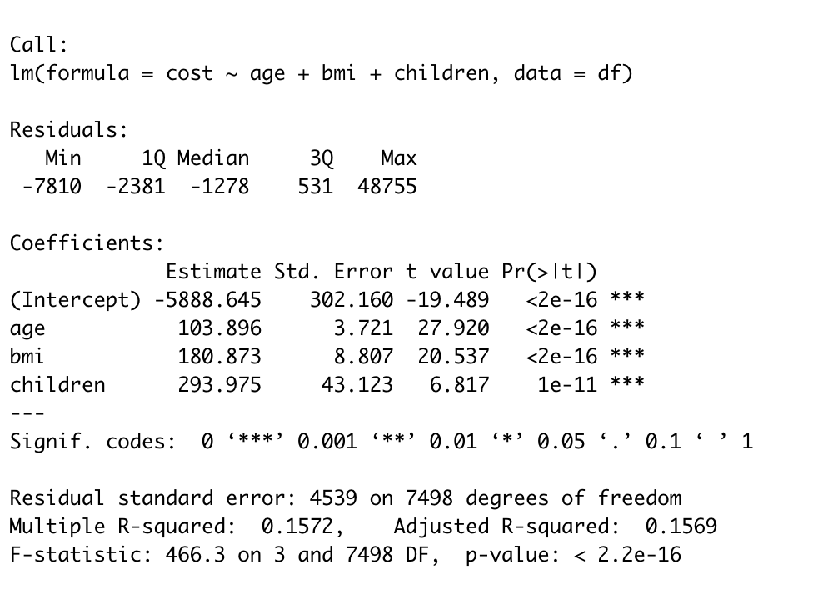
LINEAR REGRESSION MODEL
Age, BMI, and ‘Children or Not’ were the factors used
Low accuracy
Only 15.6% of those factors explained the rest of the data
Narrowed down some of the factors we should use
Not a good model, but a good starting point
11
Notes:
this is the linear regression model we created -
it didn’t have good accuracy, and the variables we used did not help explain a lot of the dataset.
so we just knew that it could be better.

Slide 12
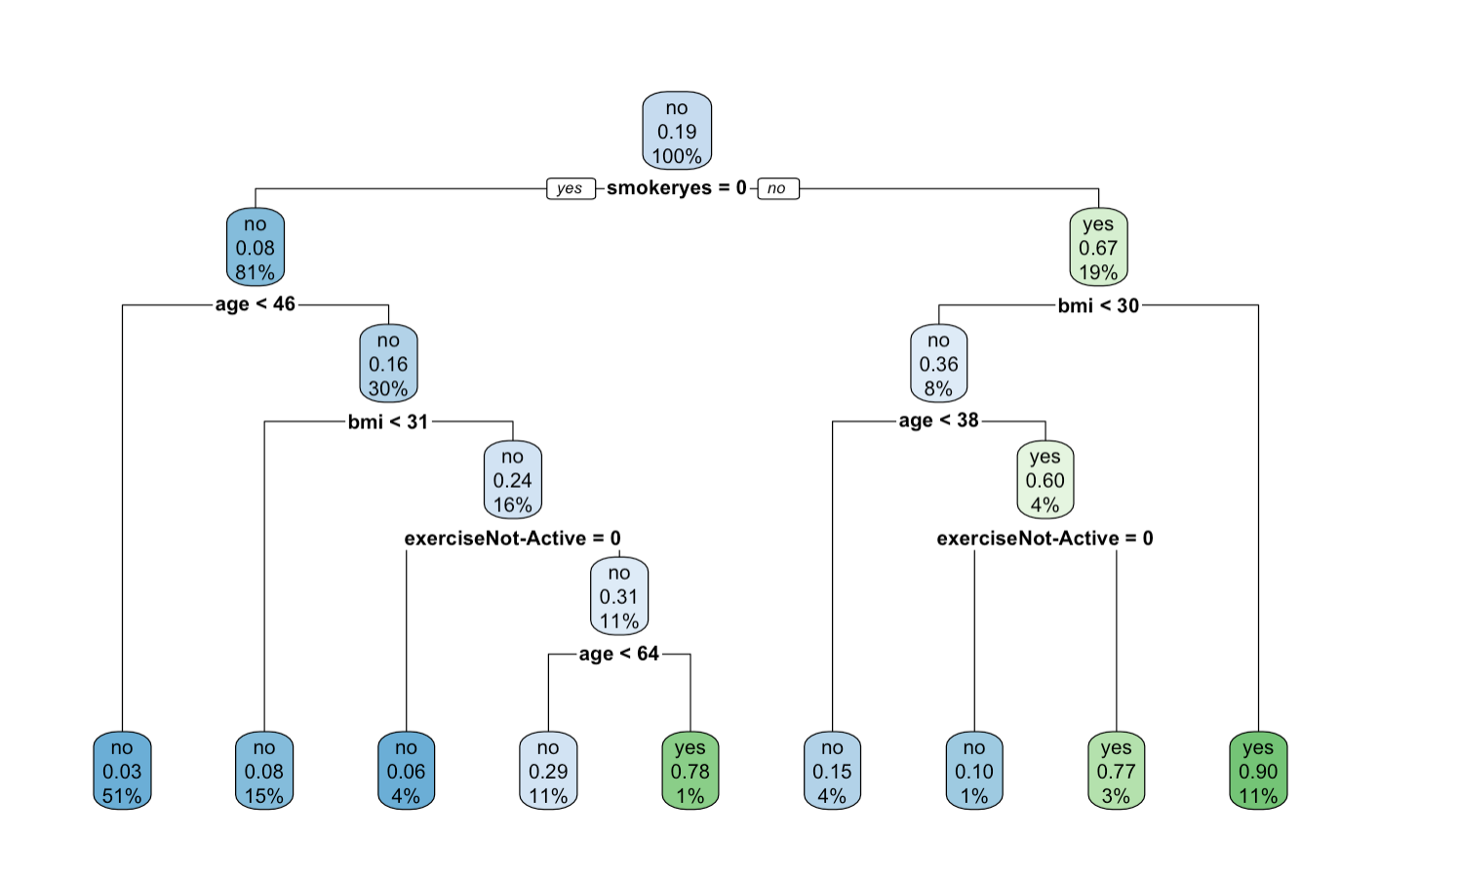
DECISION TREE 1
12

Slide 13
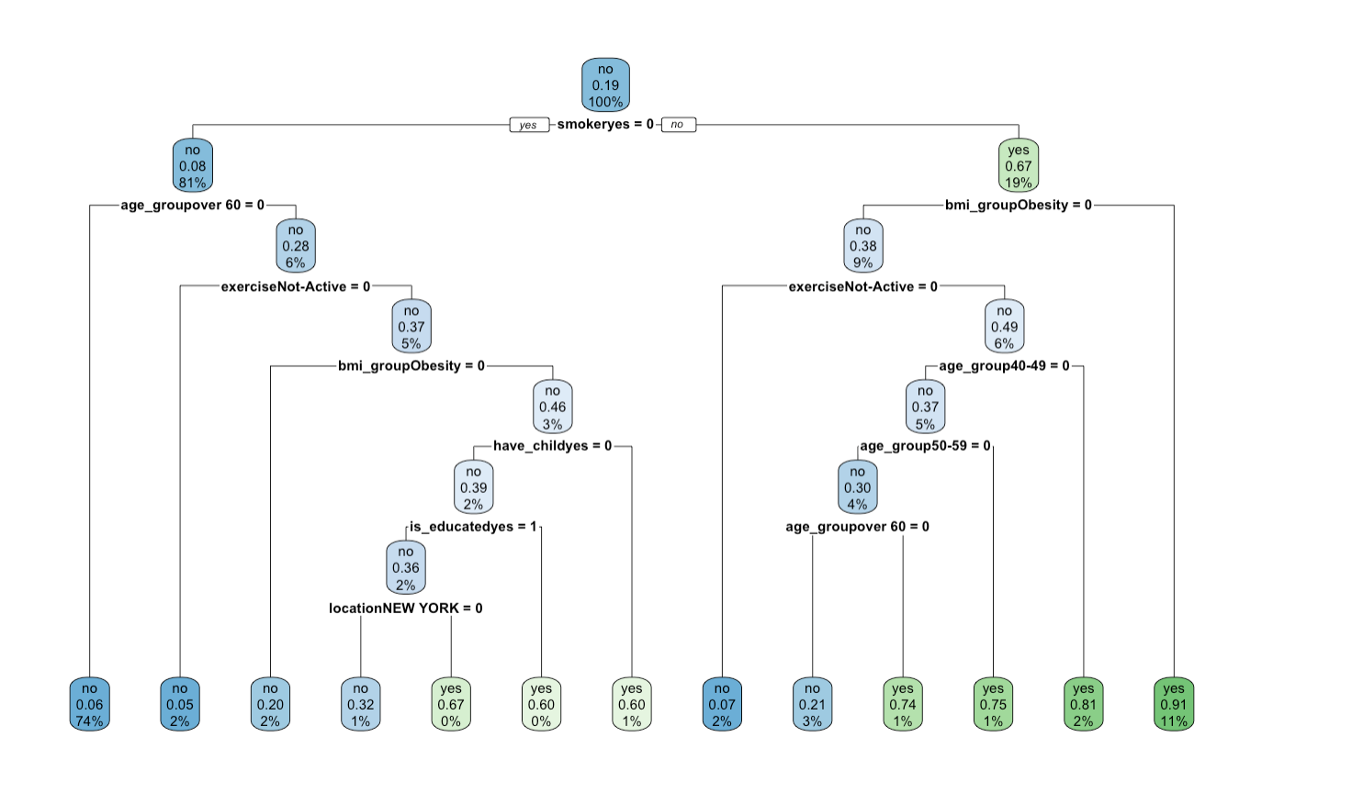
DECISION TREE 2
13

Slide 14
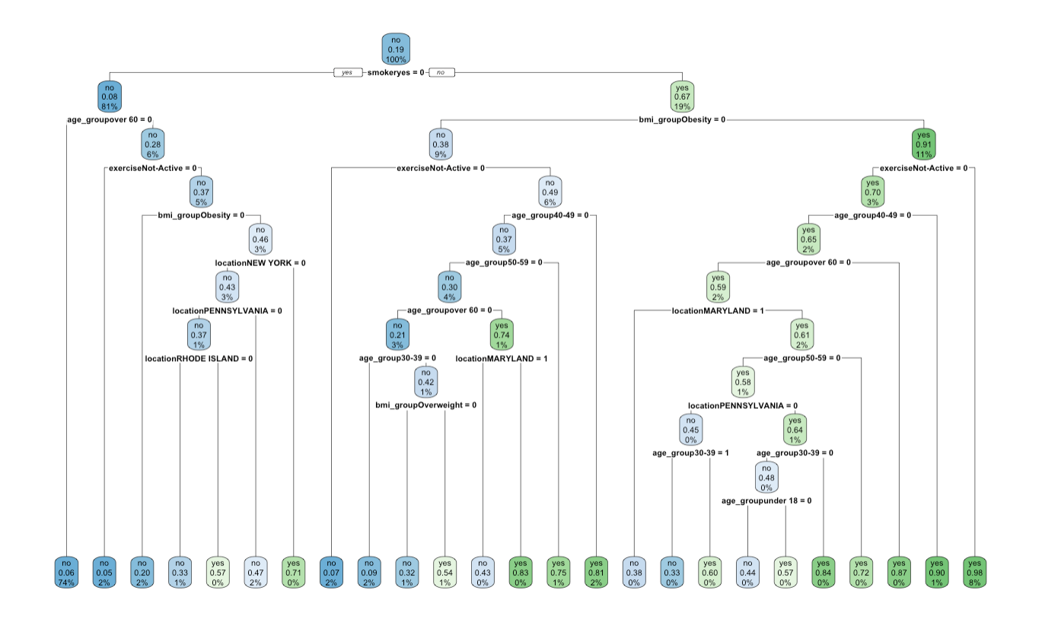
DECISION TREE 3
14
Notes:
*** i need help on interpreting decision tree 3

Slide 15
DECISION TREES
Decision Trees were one of the more complicated models used
We found that in comparison to our Linear Regression model, Decision Trees performed better.
Both Sensitivity and Accuracy increased.
Each tree we created improved every time in terms of Accuracy and Sensitivity
Through cross-analyzing factors that performed well in one model vs. how it performed in another, helped narrow down which variables to focus on.
15
Notes:
***the initial modeling of our data helped us determine important variables to focus on moving forward!!!

Slide 16
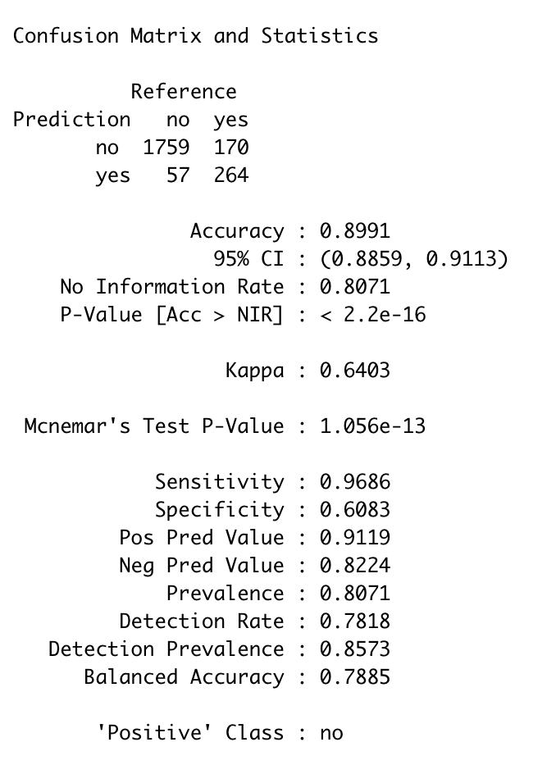
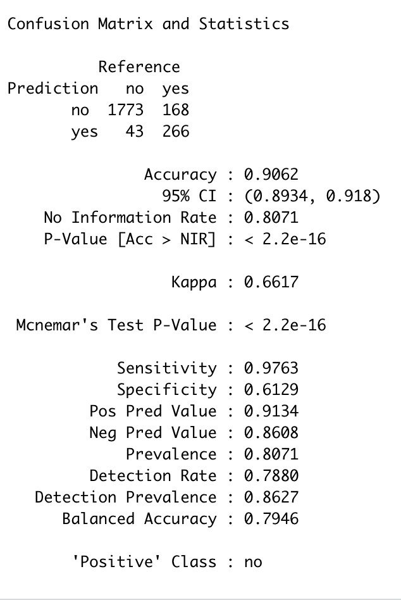
SUPERVISED VECTOR MACHINE (SVM) MODELS
These 2 SVM models worked well, but we still decided on Decision Tree Models because it was helpful with the visuals.
16
Notes:
These are SVM models that we conducted and we found that they performed well, but we

Slide 17
PHASES FOUR & FIVE
After completing all this modeling and narrowing of the variables, reflection made us realize that the standard to which we determined a person was expensive or not, was manually fixed.
17
Notes:
so we needed to find a boundary that was not manually fixed, but was supported by evidence we found in further research.

Slide 18
PHASES FOUR & FIVE
To optimize our cost boundary, which then affects the parameters of the Expensive variable, BMI was used to determine a new boundary.
BMI used because of it’s high correlation with the Expensive variable
$12,282
18
Notes:
BMI was specifically used because it was determined to be the most supported variable associated with the Expensive variable.
the new boundary that was determined from this analysis was $12,282 dollars.
so this means that now, when we do further research, a person is considered expensive if they spend greater than or equal to $12,282 on healthcare, and they’re considered not expensive when they spend less than $12,282 on healthcare.
To create the best and most supported cost boundary, we used k-means clustering to put cost into groups, and we used associate mining and determined that BMI was the most supported item associated with expensive.

Slide 19
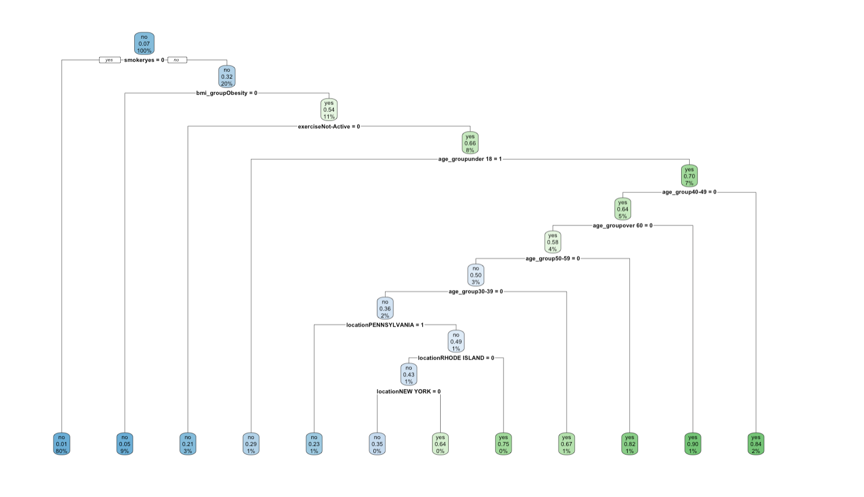
FINAL MODEL
19
Notes:
we decided to use decision tree models, with a boundary of $12,282, and with fewer factors, so that our model could work on larger datasets on population and be more generalizable.
FROM THE REPORT:
Later on, we repeated the process of decision tree model 2 and 3 and found our sensitivity had been improved with 12282 USD as the boundary
this is the model we used and stored for our shiny app.
So after determining the new standard for the Expensive column, (how we determine if a person is expensive or not), we conducted analyses on these new findings and found our best working model.
why is it the best working model?
variables were left out of this model? which ones? how do we mean?

Slide 20
THE IMPORTANT VARIABLES
From our final model, we were able to determine that age group, BMI group, smoker or not, location (state you live in), and whether or not you exercise yearly or not were the most crucial variables.
20
Notes:
FROM OUR FINAL MODEL, WE WERE ABLE TO DETERMINE THAT AGE GROUP, BMI GROUP, SMOKER OR NOT, LOCATION (STATE YOU LIVE IN), AND WHETHER OR NOT YOU EXERCISE YEARLY WERE THE MOST CRUCIAL VARIABLES IN DETERMINING WHAT PEOPLE HAD HIGH (EXPENSIVE) HEALTHCARE COSTS.

Slide 21
Bringing it back to our Focus Questions:
Why are some people’s health costs more expensive than others?
Can we predict which people will be expensive?
In terms of health care costs.
Which people will have high healthcare costs?
What are some recommendations for lowering healthcare costs?
21
Notes:
*** WE NEED TO ANSWER THESE QUESTIONS

Slide 22
Bringing it back to our Focus Questions:
1) Why are some people’s health costs more expensive than others?
Age, Health Status, Where You Live, and Lifestyle
22

Slide 23
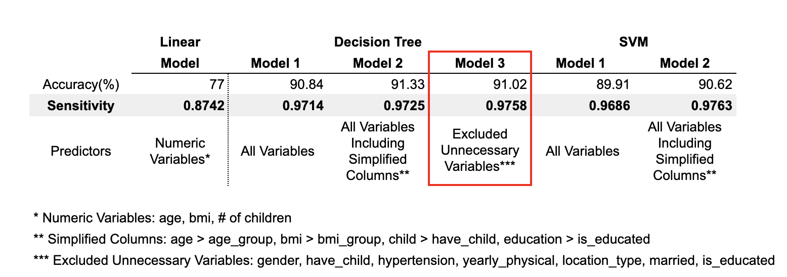
Bringing it back to our Focus Questions:
2) Can we predict which people will be expensive?
The High Accuracy
Excluded Unnecessary Variables and Simplified Predictors
23

Slide 24
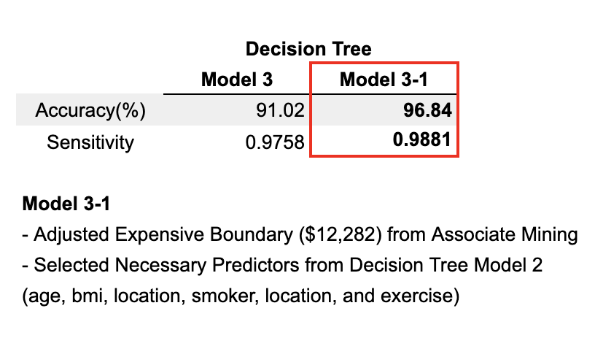
Bringing it back to our Focus Questions:
2) Can we predict which people will be expensive?
2. The Best Predictor for Calculating the Expected Healthcare Cost
Adjusted the boundary for determining the cost is expensive or not
24

Slide 25
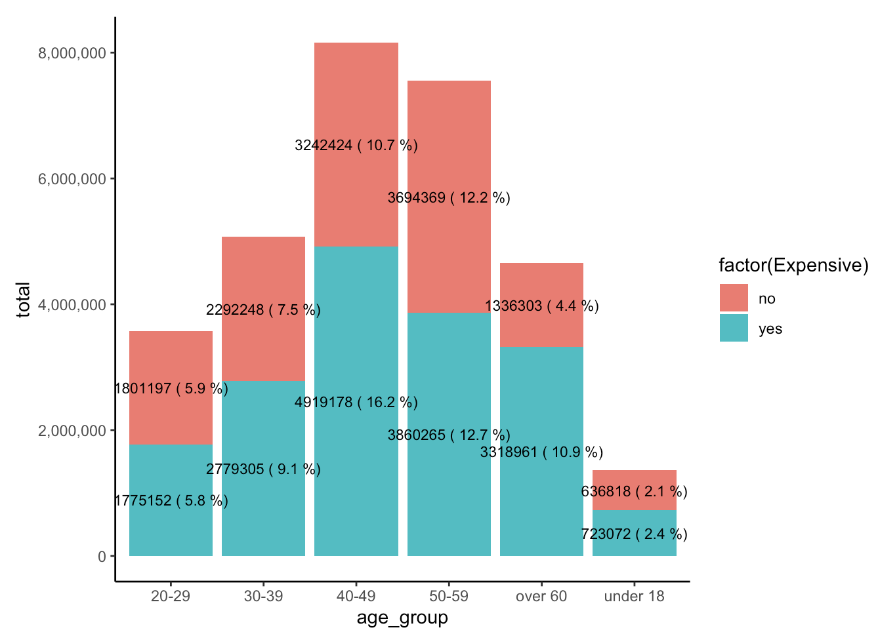
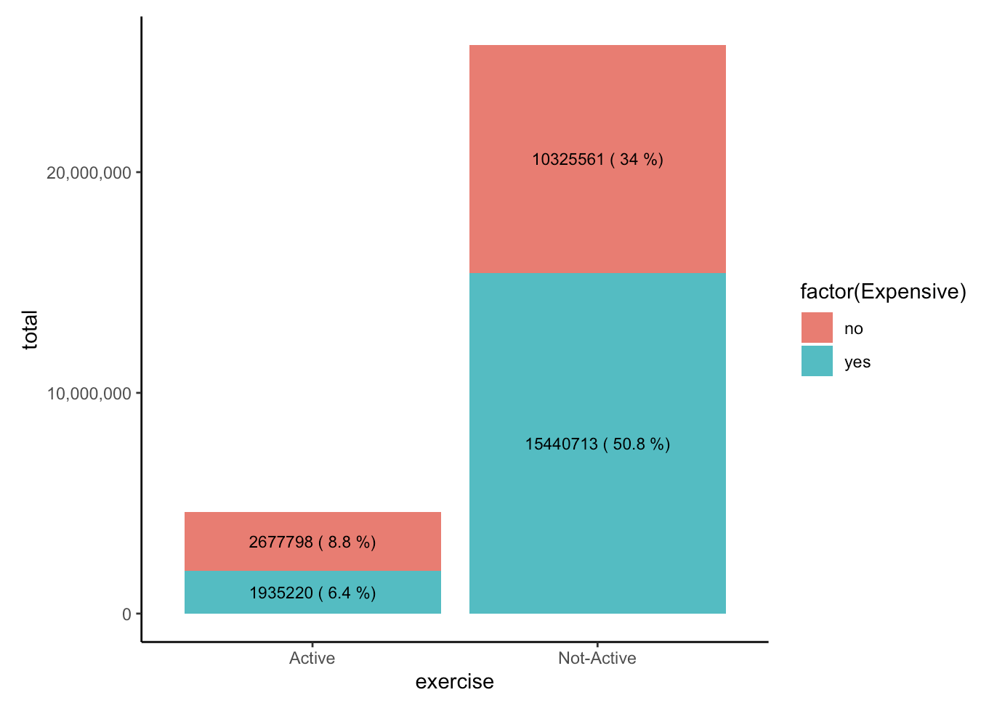
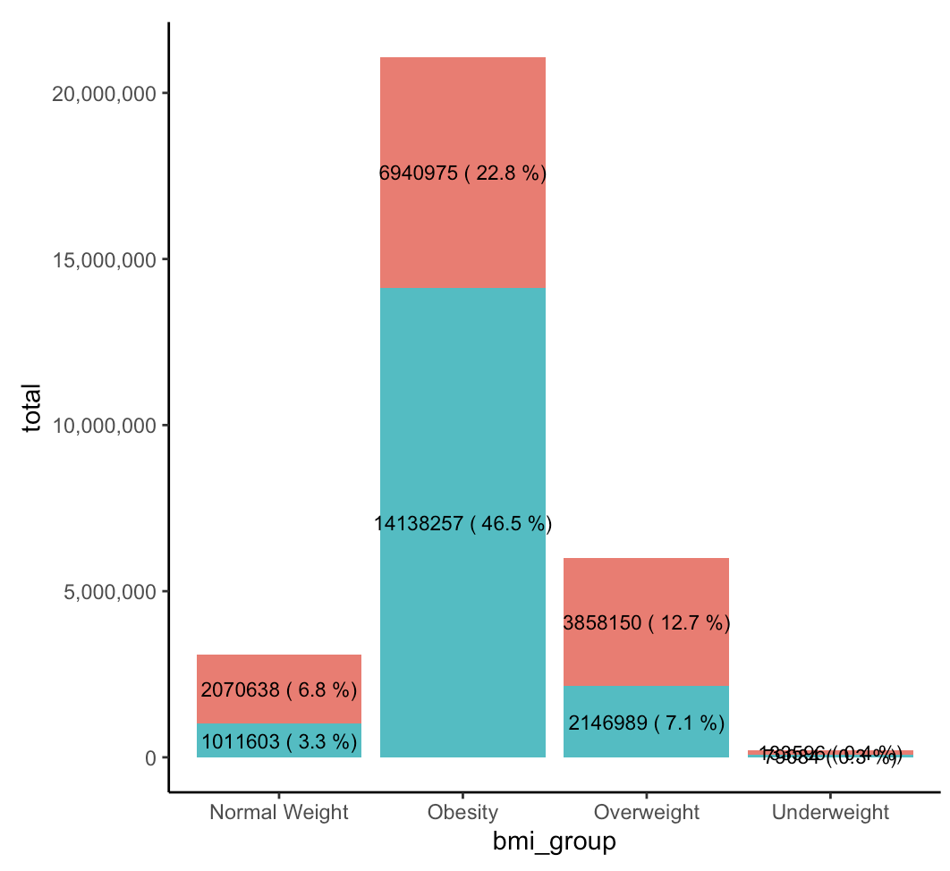
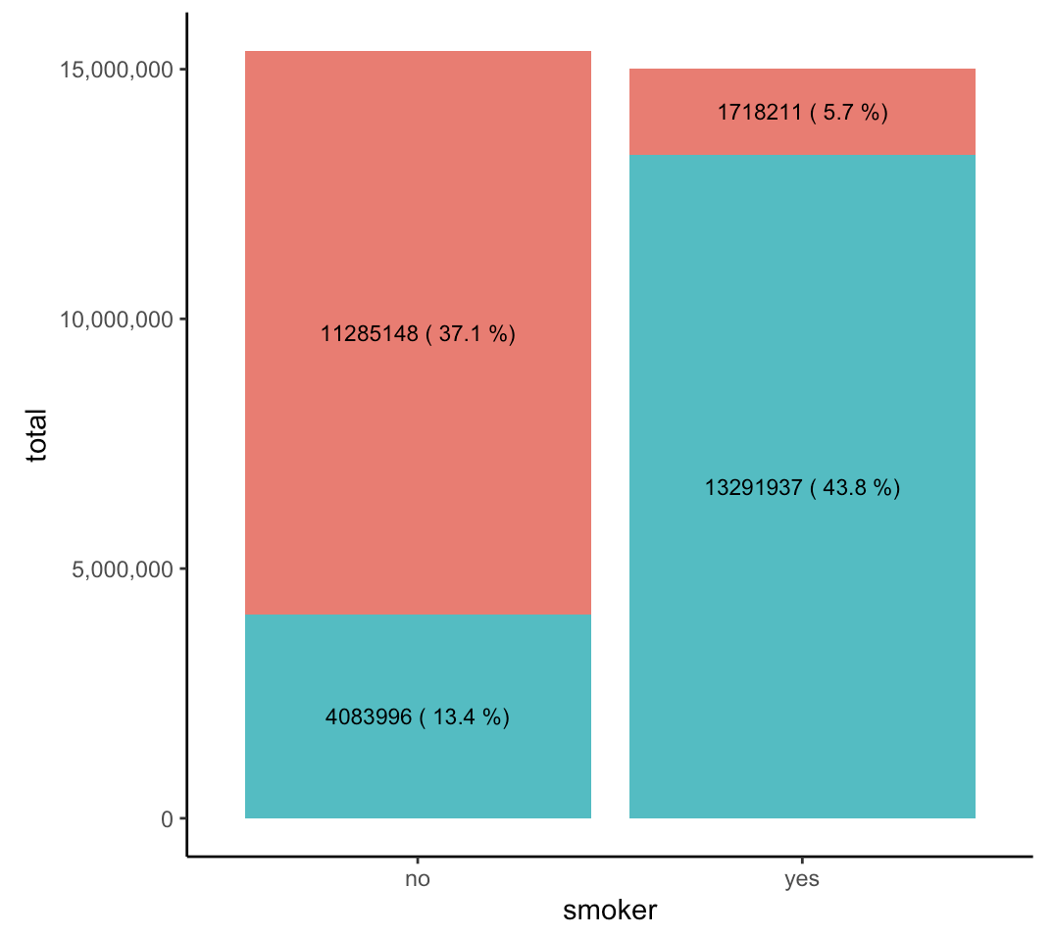
Bringing it back to our Focus Questions:
3) Which people will have high
healthcare costs?
Groups
Smokers
Obese people
Non-Active people (No Exercise)
Older Age Ranges (40-49, 50-59, Over 60)
Living in Urban places

Slide 26
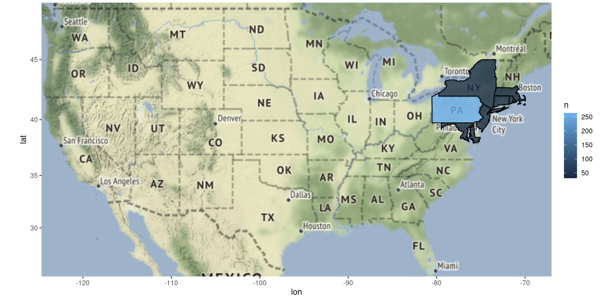
Bringing it back to our Focus Questions:
3) Which people will have high healthcare costs?
26

Slide 27
Bringing it back to our Focus Questions:
4) What are some recommendations for lowering healthcare costs?
The goal is to not have as many people in the Non-Exercise, Smoker, or Obesity groups. There is a certain age group that has higher healthcare costs, which we will inevitably have people in. But overall, we can still have their healthcare costs lowered.
27
Notes:
workplace health promotion - proper form for lifting items if they’re in a laborious job, standing desks, healthy snacks in the office, discounted gym memberships, and support for quitting smoking.
Obesity Prevention Programs - weight management → discounting or providing or promoting exercise events, or promoting exercise challenges which would also add an incentive to losing weight if there’s a prize.

Slide 28
Bringing it back to our Focus Questions:
4) What are some recommendations for lowering healthcare costs?
Lowering Administration Costs → don’t have to spend as much money collecting data that may not be significant (i.e., marital status, number of children, gender). The resources saved could then be used to fund future programs/campaigns that help lower healthcare costs for others.
28
Notes:
administration costs → to reduce admin costs we realized we don’t have to include all variables, because we found, according to our models, that some variables didn’t have a huge impact. So you don’t have spend money collecting that data, for example, marital status, number of children, or even gender.
workplace health promotion - proper form for lifting items if they’re in a laborious job, standing desks, healthy snacks in the office, discounted gym memberships, and support for quitting smoking.
Obesity Prevention Programs - weight management → discounting or providing or promoting exercise events, or promoting exercise challenges which would also add an incentive to losing weight if there’s a prize.

Slide 29
Bringing it back to our Focus Questions:
4) What are some recommendations for lowering healthcare costs?
2. Workplace Health Promotion → Engaging in preventative measures
Working with companies to campaign and partner with to encourage healthy habits.
Having healthy snacks and meals in the office
Discounted gym memberships
Programs and support for helping people to quit smoking
Standing Desks
If it’s a laborious job, demonstrating proper lifting form to prevent injury
29
Notes:
administration costs → to reduce admin costs we realized we don’t have to include all variables, because we found, according to our models, that some variables didn’t have a huge impact. So you don’t have spend money collecting that data, for example, marital status, number of children, or even gender.
workplace health promotion - proper form for lifting items if they’re in a laborious job, standing desks, healthy snacks in the office, discounted gym memberships, and support for quitting smoking.
Obesity Prevention Programs - weight management → discounting or providing or promoting exercise events, or promoting exercise challenges which would also add an incentive to losing weight if there’s a prize.

Slide 30
Bringing it back to our Focus Questions:
4) What are some recommendations for lowering healthcare costs?
2. Workplace Health Promotion → Engaging in preventative measures
Working with companies to campaign and partner with to encourage healthy habits.
Workplace exercise challenges → adding incentive to lose weight
30
Notes:
administration costs → to reduce admin costs we realized we don’t have to include all variables, because we found, according to our models, that some variables didn’t have a huge impact. So you don’t have spend money collecting that data, for example, marital status, number of children, or even gender.
workplace health promotion - proper form for lifting items if they’re in a laborious job, standing desks, healthy snacks in the office, discounted gym memberships, and support for quitting smoking.
Obesity Prevention Programs - weight management → discounting or providing or promoting exercise events, or promoting exercise challenges which would also add an incentive to losing weight if there’s a prize.

Slide 31
Bringing it back to our Focus Questions:
4) What are some recommendations for lowering healthcare costs?
3. Directly funding and creating campaigns and programs for the highest risk groups.
Obesity Prevention Programs
Smoking Cessation Campaigns/Programs
Exercise Challenges (i.e., community, workplace, or online) → adding prizes as a way to incentivize people
Promoting Exercise Events
31
Notes:
administration costs → to reduce admin costs we realized we don’t have to include all variables, because we found, according to our models, that some variables didn’t have a huge impact. So you don’t have spend money collecting that data, for example, marital status, number of children, or even gender.
workplace health promotion - proper form for lifting items if they’re in a laborious job, standing desks, healthy snacks in the office, discounted gym memberships, and support for quitting smoking.
Obesity Prevention Programs - weight management → discounting or providing or promoting exercise events, or promoting exercise challenges which would also add an incentive to losing weight if there’s a prize.

Slide 32
Bringing it back to our Focus Questions:
4) What are some recommendations for lowering healthcare costs?
Preventative measures promotes healthy habits, lifestyles, and helps prevents injury. By supporting preventative programs that target people with high healthcare costs, their costs will decrease over time.
32

Slide 33
THANK YOU
FOR LISTENING
IST 687
FALL 2022

